Slide 1
The tree labeling polytope: a unified approach to ancestral reconstruction problems
Henri Schmidt and Ben Raphael
Department of Computer Science
Notes:
Today I will be presenting our work on the tree labeling polytope, which is a new tool and framework for solving ancestral reconstruction problems which appear in phylogenetics.

Slide 2
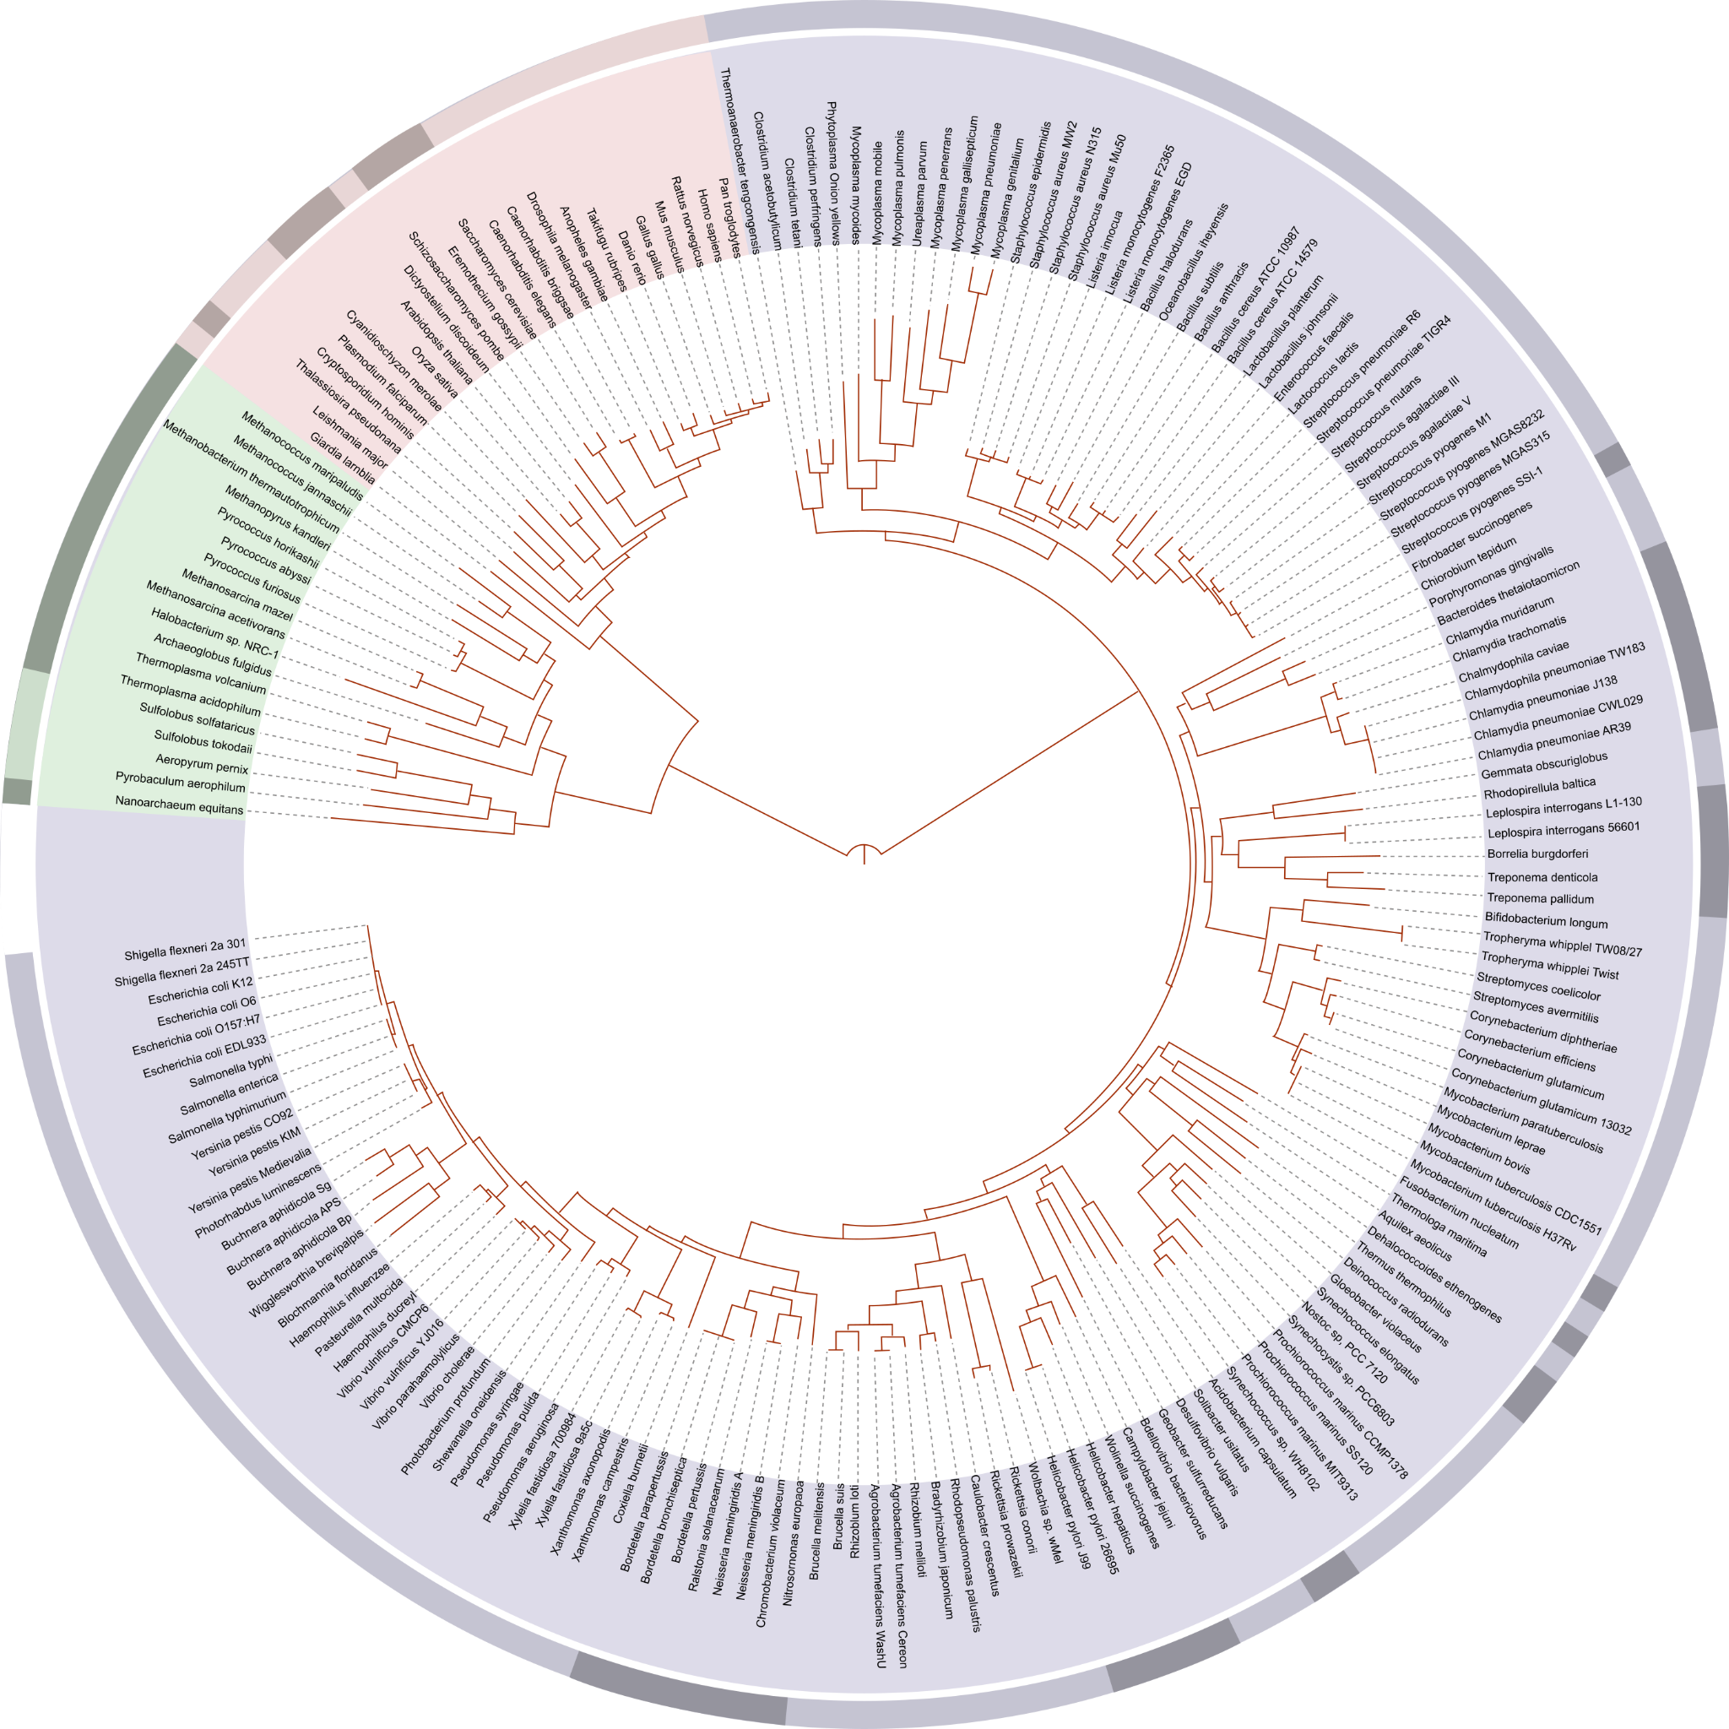
What can we infer about the past?
Eukaryotes
Given a phylogeny and attributes of species at the present day, can we recover attributes of the ancestral species?
Archaea
Prokaryotes
Notes:
The driving question behind our work is what can we infer about the past. As an example, suppose we are given a collection of species and their evolutionary relationships in the form of a phylogenetic tree. A natural question is: can we recover attributes of the ancestral species using the phylogenetic tree? For example, one may select this ancestral archaea and ask: what is the sequence of a particular gene in this species?

Slide 3
What can we infer about the past?
Eukaryotes
Given a phylogeny and attributes of species at the present day, can we recover attributes of the ancestral species?
Archaea
What is the sequence of this ancestral archaea?
Prokaryotes
Notes:
The driving question behind our work is what can we infer about the past. As an example, suppose we are given a collection of species and their evolutionary relationships in the form of a phylogenetic tree. A natural question is: can we recover attributes of the ancestral species using the phylogenetic tree? For example, one may select this ancestral archaea and ask: what is the sequence of a particular gene in this species?

Slide 4
What can we infer about the past?
Eukaryotes
Given a phylogeny and attributes of species at the present day, can we recover attributes of the ancestral species?
Archaea
What is the sequence of this ancestral archaea?
In phylogenetics, this is an example of a ancestral reconstruction problem.
Prokaryotes
Notes:
The driving question behind our work is what can we infer about the past. As an example, suppose we are given a collection of species and their evolutionary relationships in the form of a phylogenetic tree. A natural question is: can we recover attributes of the ancestral species using the phylogenetic tree? For example, one may select this ancestral archaea and ask: what is the sequence of a particular gene in this species?

Slide 5
Ancestral reconstruction is one of the oldest problems in phylogenetics
Notes:
In fact, ancestral reconstruction problems of this type are some of the oldest problems in phylogenetics, with dozens of papers written on the topic.

Slide 6
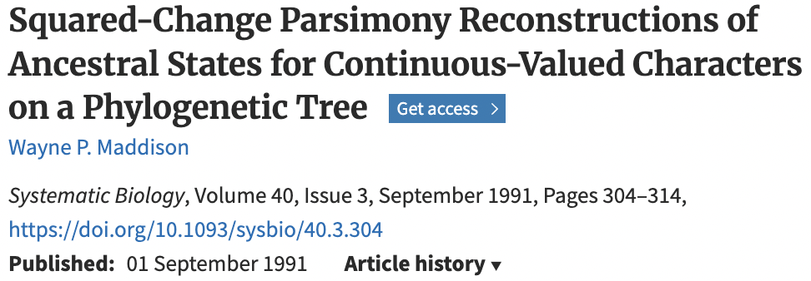
Ancestral reconstruction is one of the oldest problems in phylogenetics
Notes:
In fact, ancestral reconstruction problems of this type are some of the oldest problems in phylogenetics, with dozens of papers written on the topic.

Slide 7
Ancestral reconstruction is one of the oldest problems in phylogenetics
⋮
Notes:
In fact, ancestral reconstruction problems of this type are some of the oldest problems in phylogenetics, with dozens of papers written on the topic.

Slide 8
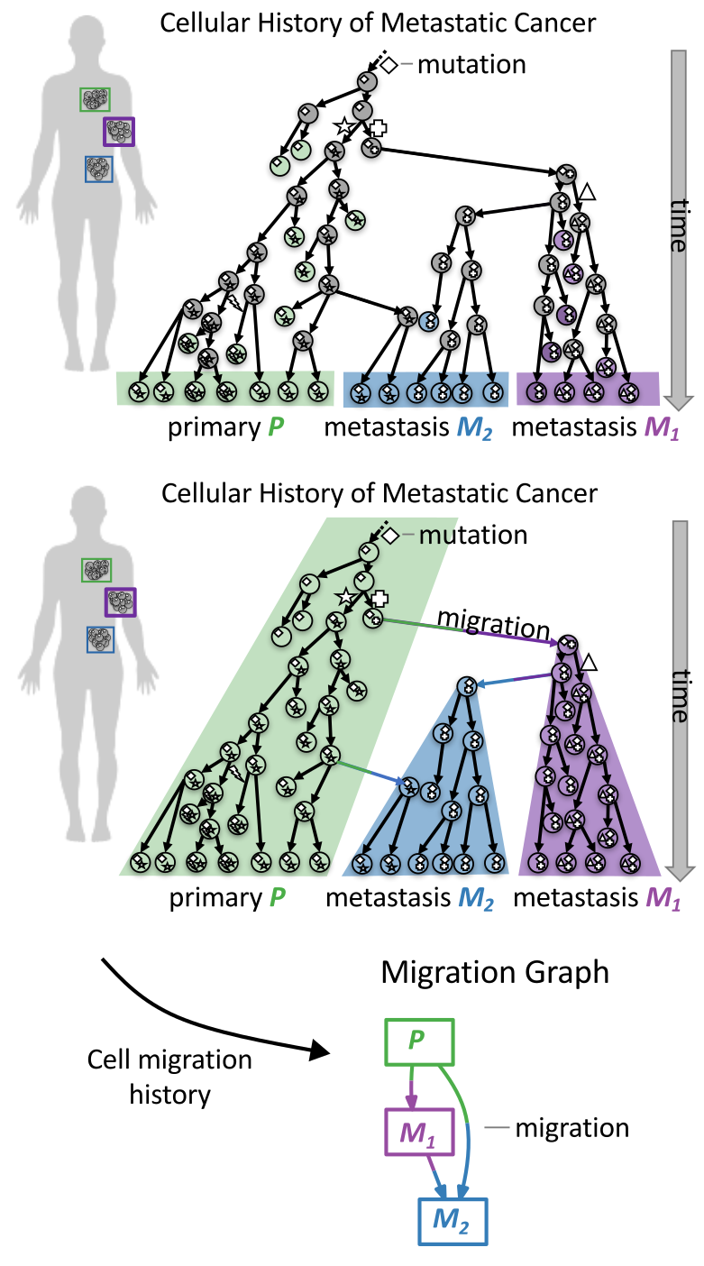
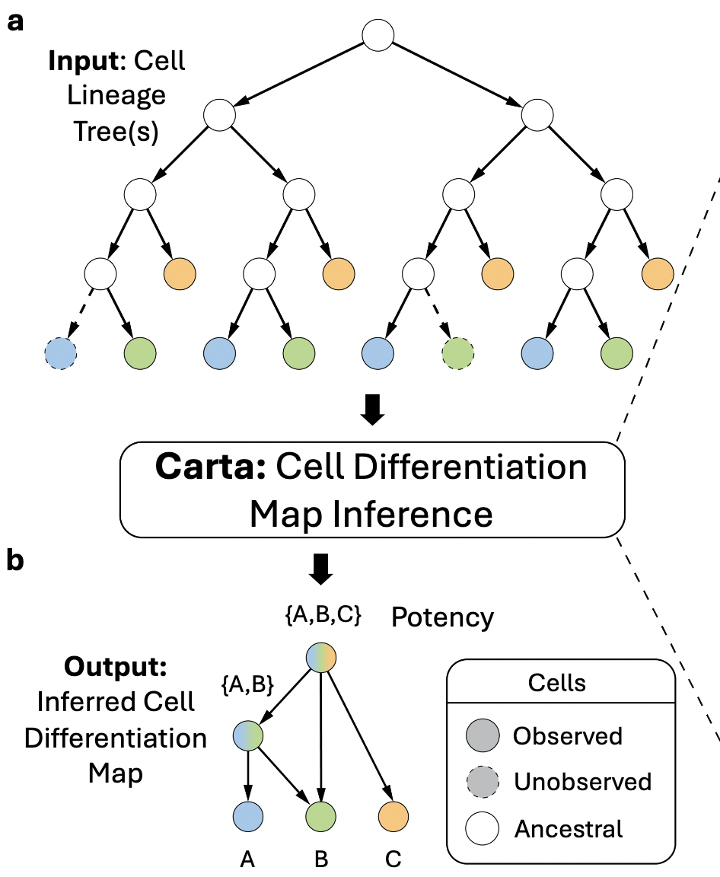
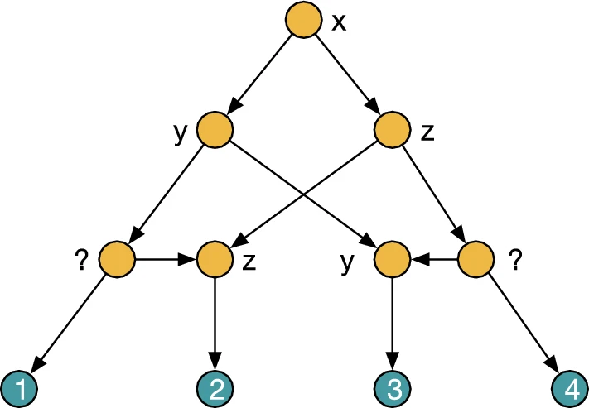
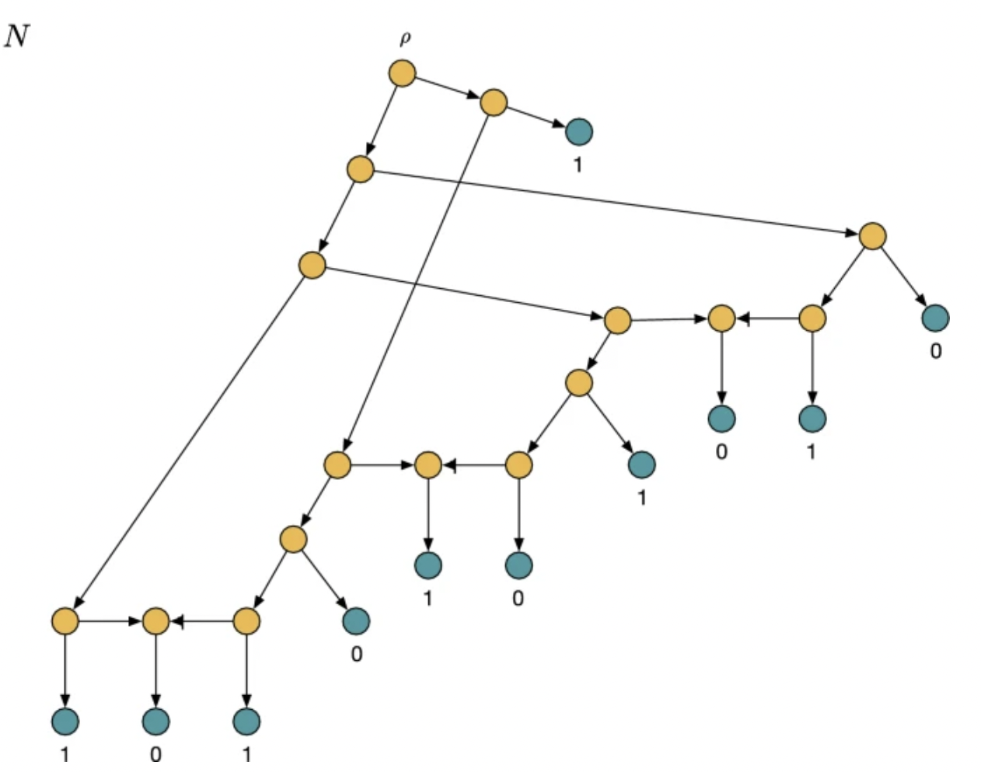
Ancestral reconstruction problems also have modern applications
To infer anatomical locations of ancestral cells, e.g. MACHINA, MACH2, Metient, and others (Quinn et al. 2021).
Scoring and ranking of phylogenetic networks [], which are popular models of hybridization and recombination.
CARTA [1] views cellular differentiation map inference as an ancestral reconstruction problem.
Notes:
However, ancestral reconstruction problems also have modern applications. For example, one of the applications we are very interested in comes from tumor phylogenetics. Here, we are provided with the cellular division history of the tumor as well the anatomical locations of the extant cells and we want to infer the anatomical locations of the ancestral cells.

Slide 9
Ancestral reconstruction problems also have modern applications
To infer anatomical locations of ancestral cells, e.g. MACHINA, MACH2, Metient, and others (Quinn et al. 2021).
Scoring and ranking of phylogenetic networks [], which are popular models of hybridization and recombination.
CARTA [1] views cellular differentiation map inference as an ancestral reconstruction problem.

Slide 10
Ancestral reconstruction problems also have modern applications
To infer anatomical locations of ancestral cells, e.g. MACHINA, MACH2, Metient, and others (Quinn et al. 2021).
Scoring and ranking of phylogenetic networks [], which are popular models of hybridization and recombination.
CARTA [1] views cellular differentiation map inference as an ancestral reconstruction problem.

Slide 11
Ancestral reconstruction problems also have modern applications
To infer anatomical locations of ancestral cells, e.g. MACHINA, MACH2, Metient, and others (Quinn et al. 2021).
To score and rank phylogenetic networks, which are popular models of hybridization and recombination.
CARTA [1] views cellular differentiation map inference as an ancestral reconstruction problem.

Slide 12
Ancestral reconstruction problems also have modern applications
To infer anatomical locations of ancestral cells, e.g. MACHINA, MACH2, Metient, and others (Quinn et al. 2021).
To score and rank phylogenetic networks, which are popular models of hybridization and recombination.
To infer progenitor cell types in developing organisms, e.g. with CARTA.
Notes:
Interestingly, the problem of inferring differentiation trajectories in developing systems has also been viewed as an ancestral reconstruction problem

Slide 13
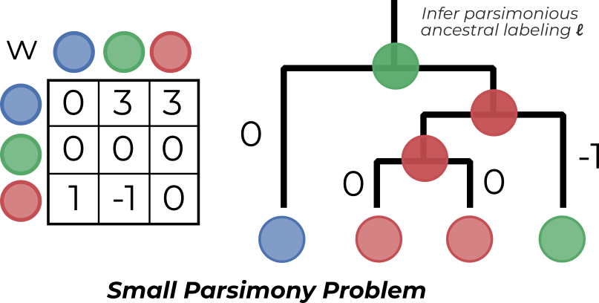
Ancestral reconstruction via dynamic programming
Small Parsimony Problem. Given a tree T = (V(T), E(T)), a label set Ω = {1, …, m} and a cost function w, find the ancestral labeling ℓ : V(T) → Ω such that the total transition cost
is minimized.
This is solved in O(nm²)* time where n is the number of edges using the Sankoff-Rousseau recurrence:
* Optimal when the cost function w is provided as input.
Notes:
Using the Sankoff-Rousseau recurrence, which expresses the optimal solution for the subtree rooted at a node in terms of the optimal solutions for the subtree rooted at the nodes children

Slide 14
Ancestral reconstruction via dynamic programming
Small Parsimony Problem. Given a tree T = (V(T), E(T)), a label set Ω = {1, …, m} and a cost function w, find the ancestral labeling ℓ : V(T) → Ω such that the total transition cost
is minimized.
This is solved in O(nm²)* time where n is the number of edges using the Sankoff-Rousseau recurrence:
* Optimal runtime when the cost function is provided as input.
Notes:
If you have taken an introductory bioinformatics course, you may seen the solution to this problem before. This is solved with Sankoff’s algorithm, which is a bottom-up dynamic programming algorithm based off the Sankoff-Rousseau recurrence. This algorithm takes O(nm^2) time, where n is the number of edges in the tree and m is the number of labels.

Slide 15
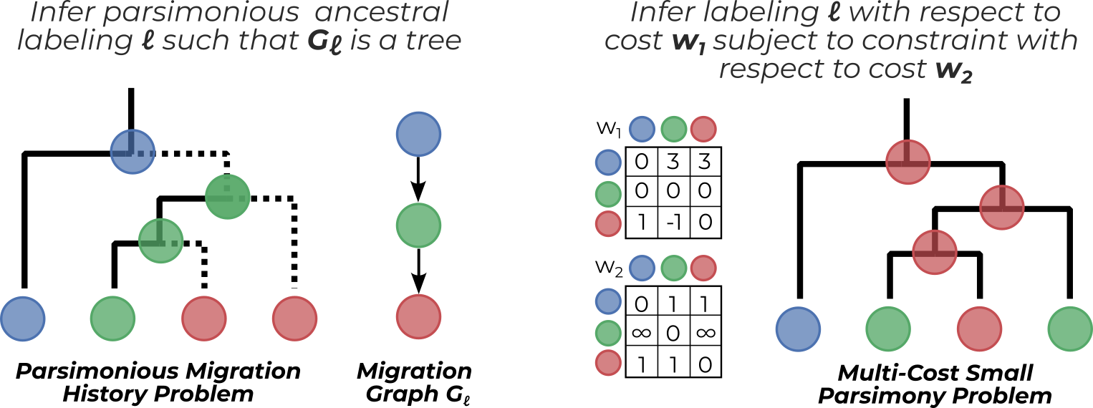
Dynamic programming algorithms often fail for structured ancestral reconstruction problems
When global constraints are placed on the ancestral labeling, the Sankoff-Rousseau recurrence breaks.
Notes:
Unsurprisingly, as these are NP-hard optimization problems they cannot be solved with a poly-time algorithm

Slide 16
Dynamic programming algorithms often fail for structured ancestral reconstruction problems
When global constraints are placed on the ancestral labeling, the Sankoff-Rousseau recurrence breaks.
Notes:
Unsurprisingly, as these are NP-hard optimization problems they cannot be solved with a poly-time algorithm

Slide 17
Dynamic programming algorithms often fail for structured ancestral reconstruction problems
When global constraints are placed on the ancestral labeling, the Sankoff-Rousseau recurrence breaks.
Notes:
Unsurprisingly, as these are NP-hard optimization problems they cannot be solved with a poly-time algorithm

Slide 18
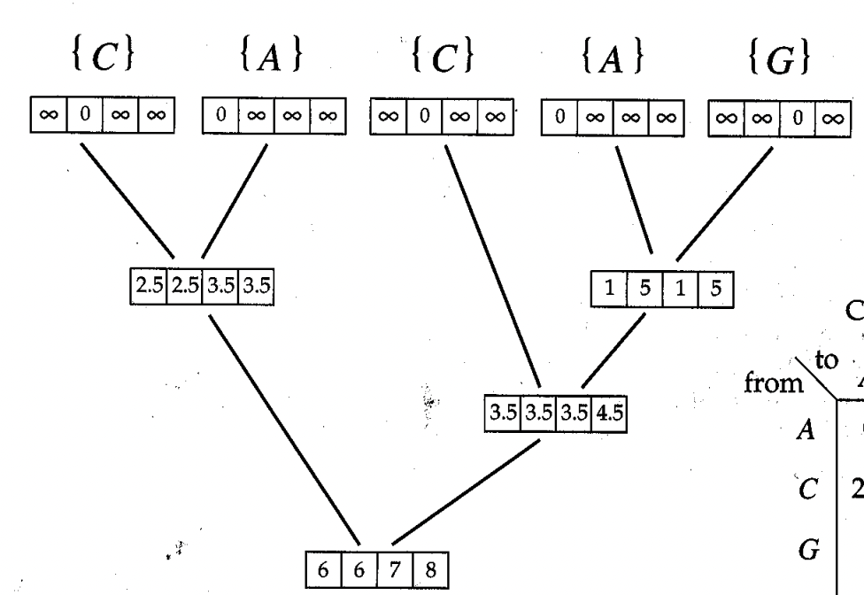
A linear programming approach to ancestral reconstruction
Dynamic programming

Slide 19
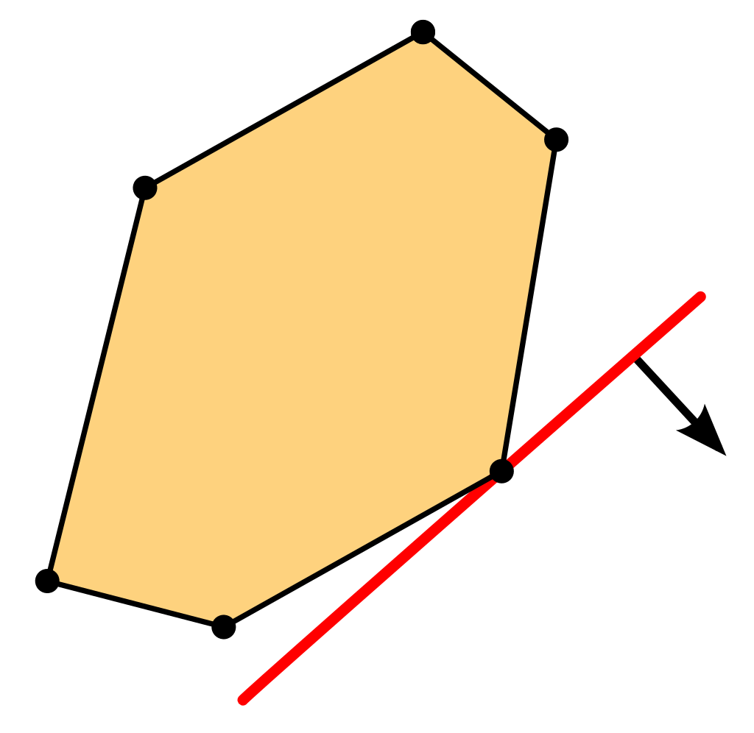
A linear programming approach to ancestral reconstruction
Dynamic programming
Linear programming
Goal: Design a linear programming formulation of the small parsimony problem which extends to structured reconstruction settings.
Extends to structured problems using additional constraints and variables
Follows approaches in theoretical computer science: e.g. state-of-the-art algorithms for maximum flow and spanning tree problems use linear programming

Slide 20
A linear programming approach to ancestral reconstruction
Dynamic programming
Linear programming
Goal: Design a linear programming formulation of the small parsimony problem which extends to structured reconstruction settings.
Extends to structured problems using additional constraints and variables
Follows approaches in theoretical computer science: e.g. state-of-the-art algorithms for maximum flow and spanning tree problems use linear programming

Slide 21
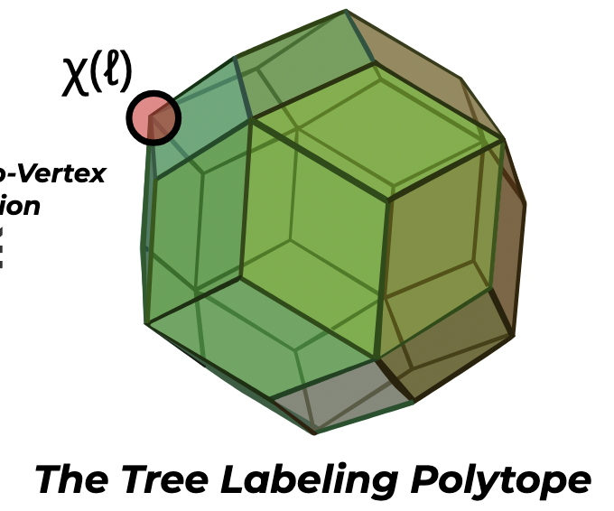
A linear program for the small parsimony problem
Theorem. Polynomial sized linear programming formulation
Theorem (Informal). The small parsimony problem is solved with a linear program containing O(nm²) variables and constraints.
Key Technical Ideas:
Introduce the tree labeling polytope whose vertices χ(ℓ) are in one-to-one correspondence with the tree labelings ℓ.
Use a primal-dual packing argument to show that the tree labeling polytope has a polynomial-sized description

Slide 22
A linear program for the small parsimony problem
Theorem. Polynomial sized linear programming formulation
Theorem (Informal). The small parsimony problem is solved with a linear program containing O(nm²) variables and constraints.
Key Technical Ideas:
Introduce the tree labeling polytope whose vertices χ(ℓ) are in one-to-one correspondence with the tree labelings ℓ.
Use a primal-dual packing argument to show that the tree labeling polytope has a polynomial-sized description

Slide 23
Algorithms for structured ancestral reconstruction problems using the tree labeling polytope
Algorithm for parsimonious migration history problem which scales to large lineage trees out of reach of current approaches.
Algorithm for softwired small parsimony problem on phylogenetic networks which outperforms existing approaches.
Algorithm for convex recoloring problem on trees by drawing connections to the multi-cost small parsimony problem.
Notes:
Interestingly, the problem of inferring differentiation trajectories in developing systems has also been viewed as an ancestral reconstruction problem

Slide 24
Algorithms for structured ancestral reconstruction problems using the tree labeling polytope
Algorithm for parsimonious migration history problem which scales to large lineage trees out of reach of current approaches.
Algorithm for softwired small parsimony problem on phylogenetic networks which outperforms existing approaches.
Algorithm for convex recoloring problem on trees by drawing connections to the multi-cost small parsimony problem.
Notes:
Interestingly, the problem of inferring differentiation trajectories in developing systems has also been viewed as an ancestral reconstruction problem

Slide 25
Algorithms for structured ancestral reconstruction problems using the tree labeling polytope
Algorithm for parsimonious migration history problem which scales to large lineage trees out of reach of current approaches.
Algorithm for softwired small parsimony problem on phylogenetic networks which outperforms existing approaches.
Algorithm for convex recoloring problem on trees by drawing connections to the multi-cost small parsimony problem.
Notes:
Interestingly, the problem of inferring differentiation trajectories in developing systems has also been viewed as an ancestral reconstruction problem

Slide 26
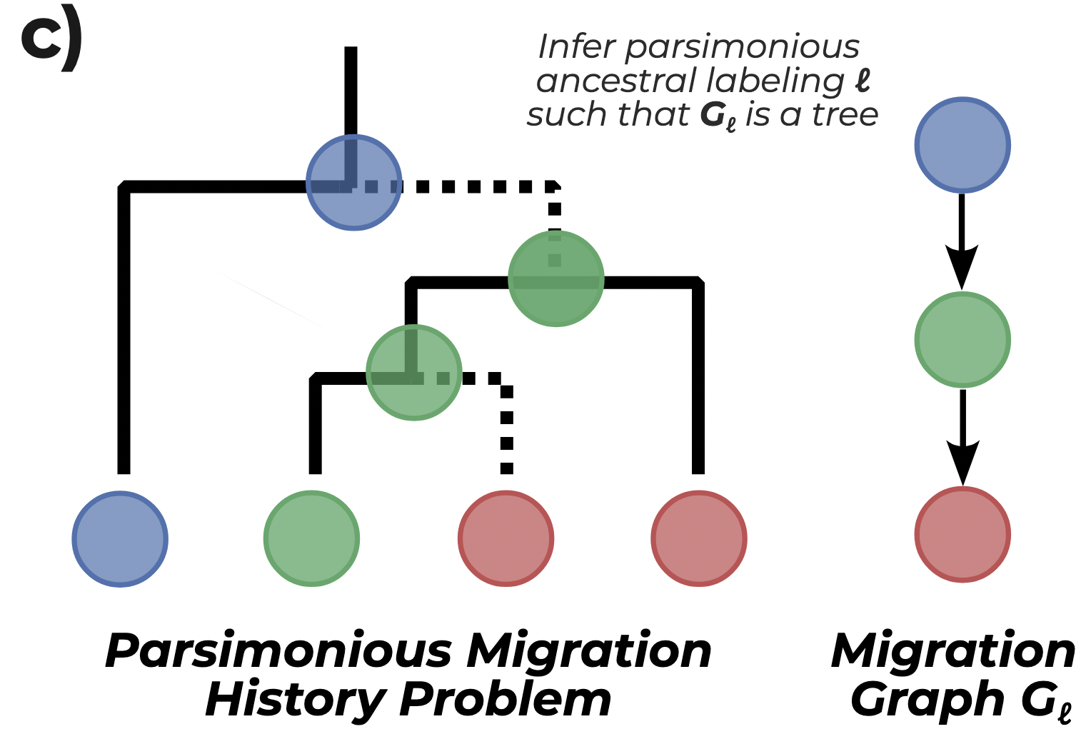
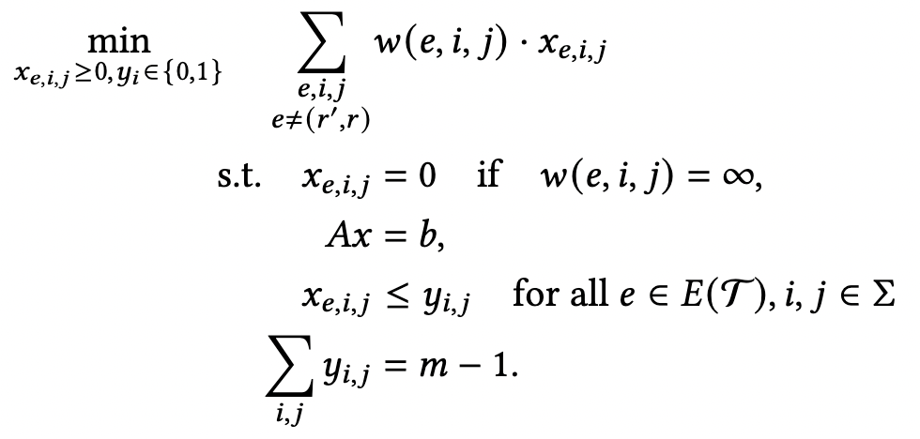
Application: the parsimonious migration history problem
MILP
We develop a mixed integer linear program (MILP) for the parsimonious migration history problem has several nice properties:
Fixed parameter tractable with only m² binary variables (m = # anatomical sites)
Strong linear relaxations, quantified in terms of the Lagrangian relaxation
Contrasts state-of-the-art algorithm MACHINA (El-Kebir et al. 2018), which has O(nm) binary variables and worse linear relaxations.

Slide 27
Application: the parsimonious migration history problem
MILP
We develop a mixed integer linear program (MILP) for the parsimonious migration history problem has several nice properties:
Fixed parameter tractable with only m² binary variables (m = # anatomical sites)
Strong linear relaxations, quantified in terms of the Lagrangian relaxation
Contrasts state-of-the-art algorithm MACHINA (El-Kebir et al. 2018), which has O(nm) binary variables and worse linear relaxations.

Slide 28
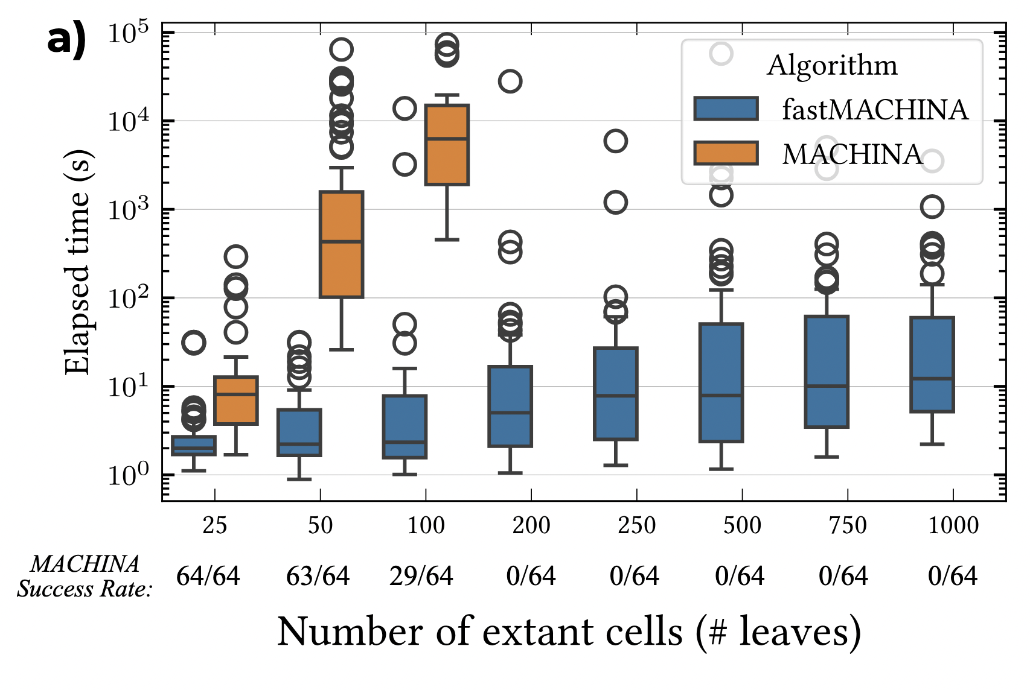
fastMACHINA for the parsimonious migration history (PMH) problem
Runtime of fastMACHINA and MACHINA (El-Kebir et al. 2018)
Simulate tumor evolution and metastasis using a fitness based model:
n = 25, 50, …, 1000 leaves
m = 3, …, 71 anatomical sites with a median of 12 sites
Tree and DAG migration patterns
Notes:
I haven’t introduced MACHINA yet, so this is strange

Slide 29
fastMACHINA enables large-scale migration history inference on lineage tracing data
(Quinn et al. 2021) builds cellular lineage trees from evolving mouse tumors.

Slide 30
Application: large-scale migration history inference on lineage tracing data
Inferred CP3 Migration Graphs
Structural
Constraints:
None
DAG
Tree
Anatomical Site
Legend (5616 cells)
Number of
Migrations:
118
266
982

Slide 31
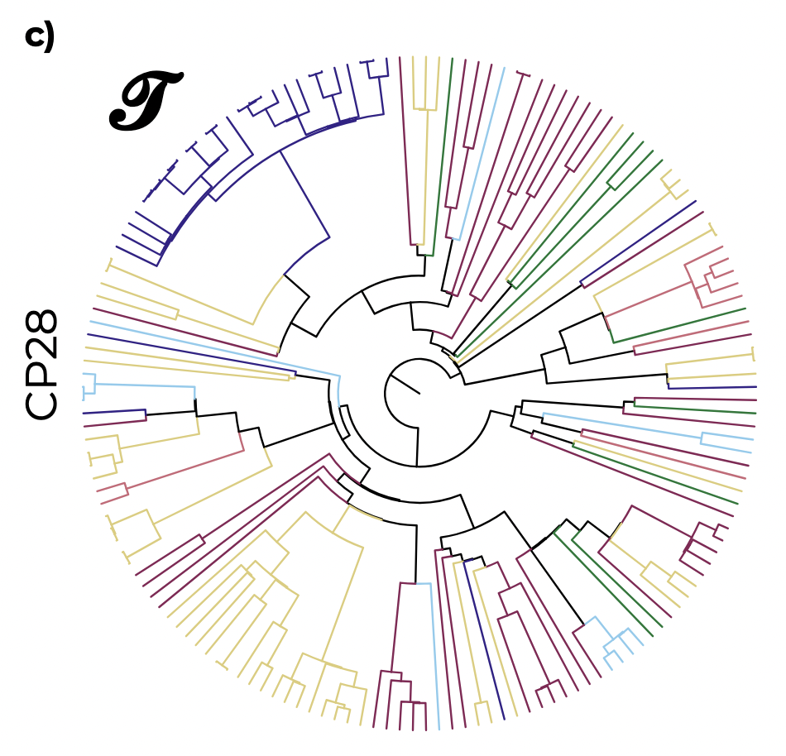
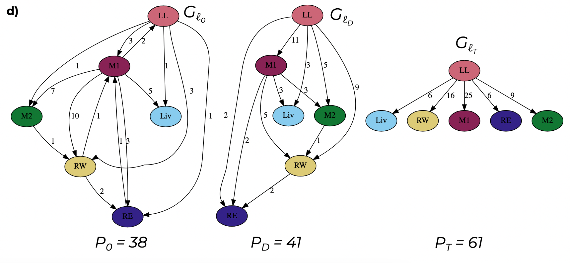
Application: large-scale migration history inference on lineage tracing data
Inferred CP28 Migration Graphs
Structural
Constraints:
None
DAG
Tree
CP28 Lineage Tree
(180 cells)
Number of
Migrations:
38
41
61

Slide 32
Conclusion
Derived a polynomial-sized linear programming algorithm for the small parsimony problem
Introduced the tree labeling polytope, a new tool for discrete ancestral labeling problems
Used the tree labeling polytope to develop state-of-the-art MILP formulations for the following structured reconstruction problems:
The parsimonious migration history problem studied in MACHINA
The convex recoloring problem on trees
The softwired small parsimony problem on phylogenetic networks
The cell-fate differentiation mapping problem introduced in CARTA
(Not Shown)
(Not Shown)
(Not Shown)

Slide 33
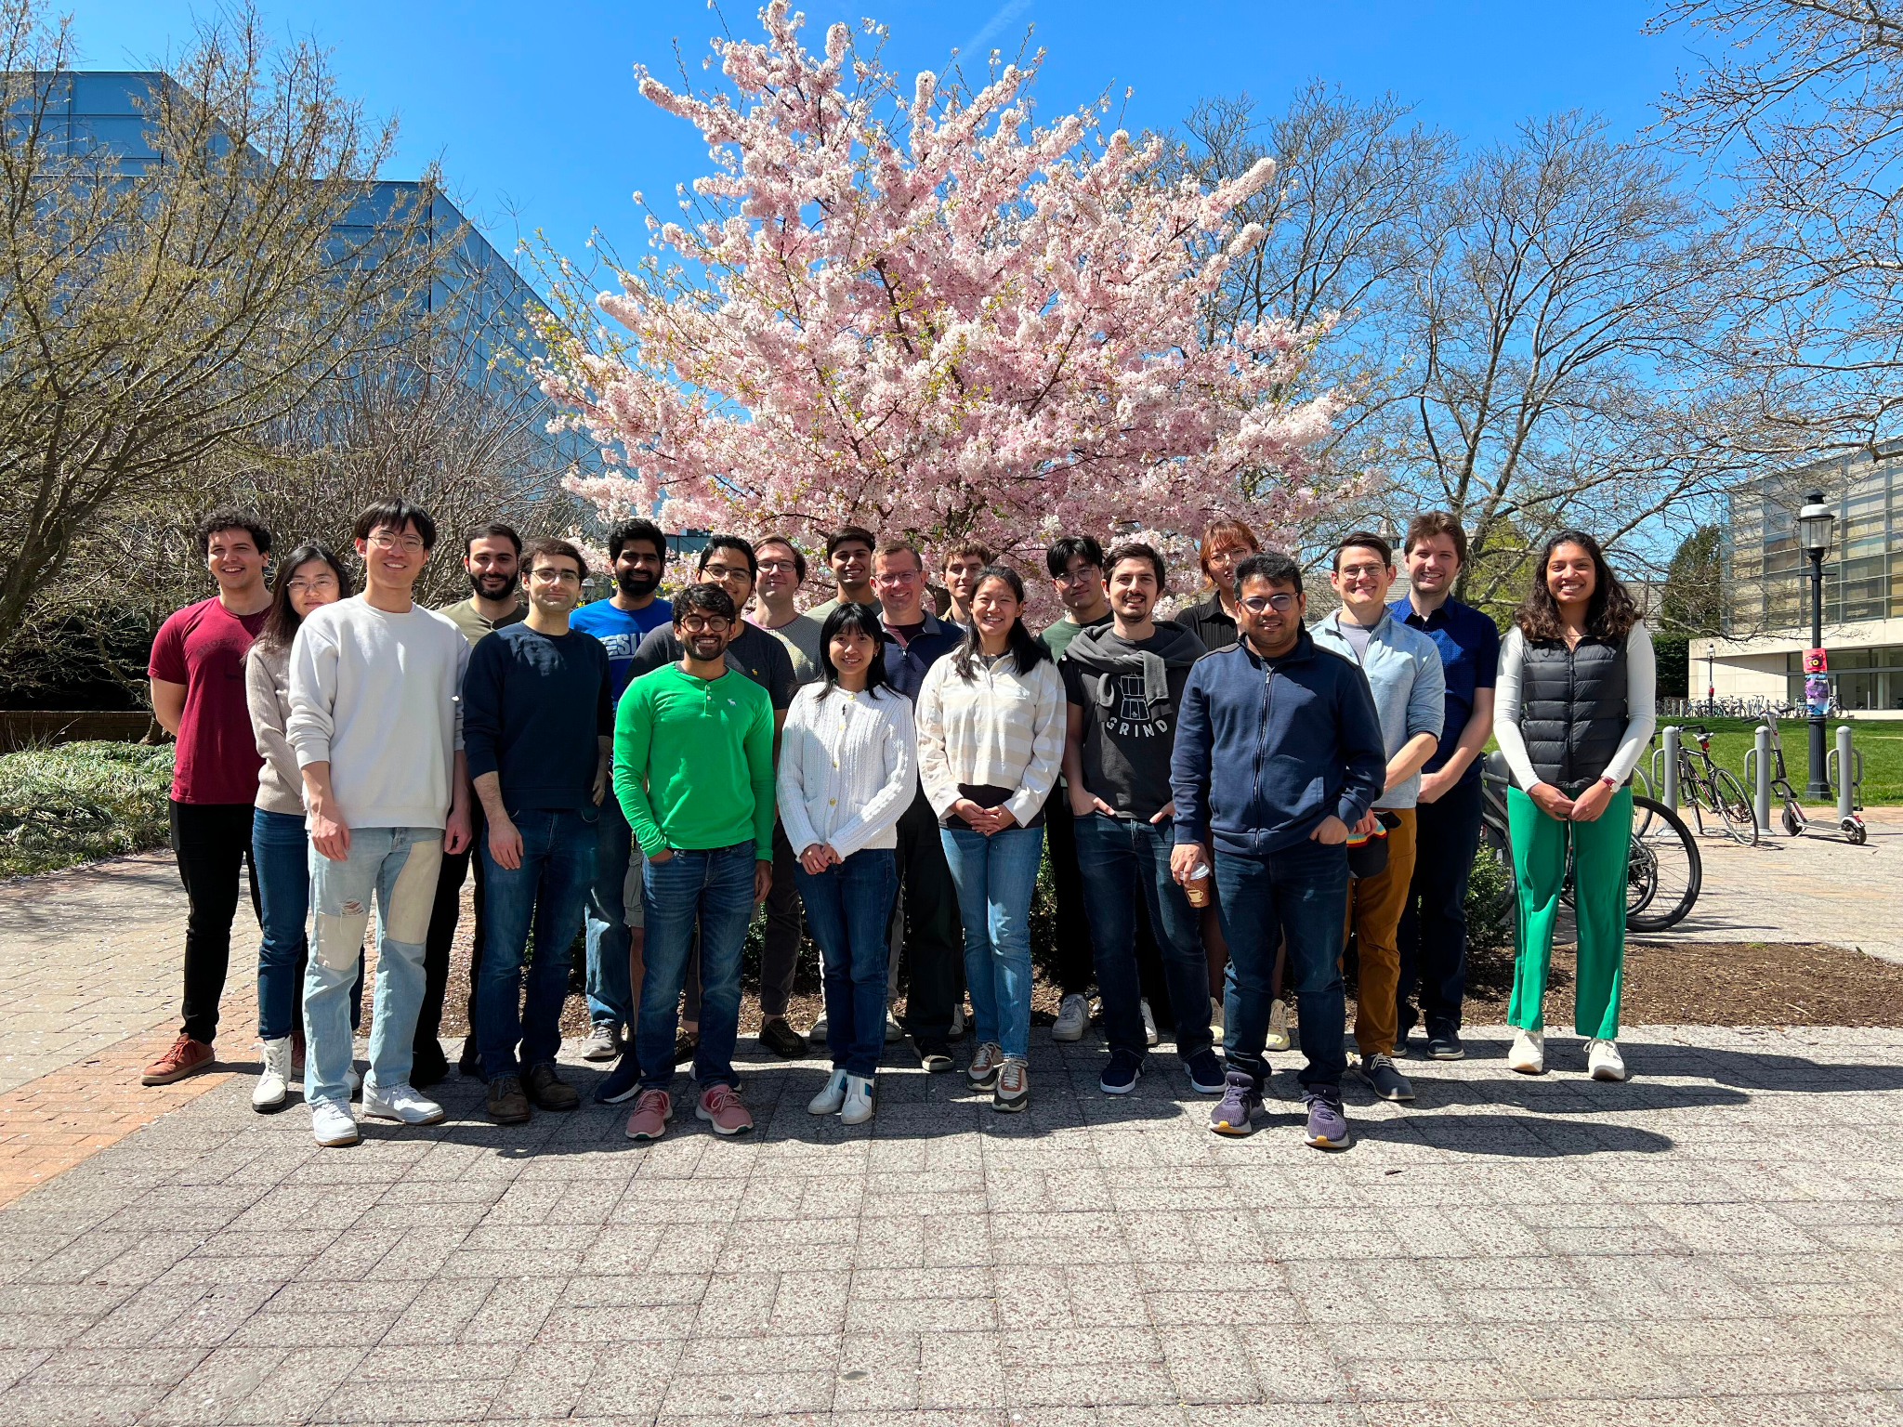
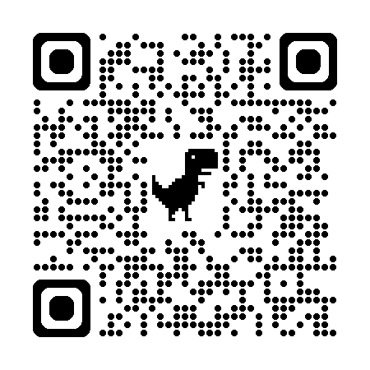
Thank You
Group Members
Ben Raphael
Sereno Lopez-Darwin
Hirak Sarkar
Richard Zhang
Peter Halmos
William Howard-Snyder
Hongyu Zheng
Yihang Shen
Michael Wilson
Gillian Chu
Xinhao Liu
Henri Schmidt
Ahmed Shuaibi
Akhil Jakatdar
Gary Hu
Clover Zheng
Viola Chen
Julian Gold
The Raphael Lab
Presentation slides are available at henricschmidt.com
The tree labeling polytope repository is available on GitHub
The manuscript is available on bioRxiv

